Slide 1

NEW MEXICO DRE PROGRAM
LAW ENFORCEMENTS’ APPROACH TO DRUG IMPAIRED DRIVING

Slide 2
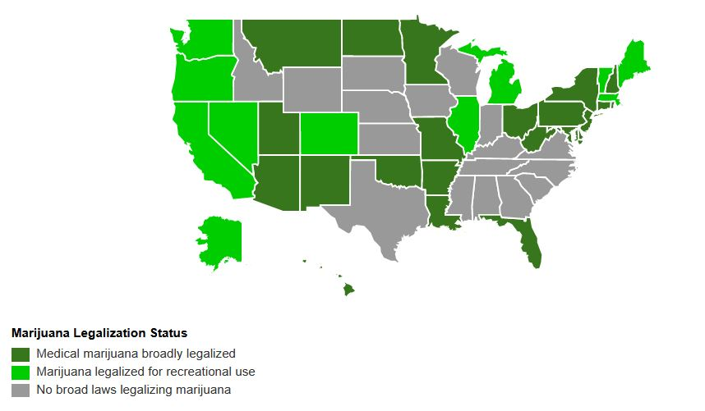

Slide 3

Marijuana in the united states
33 States Legalized on some level (Medical)
11 States & D.C. Legalized recreationally

Slide 4
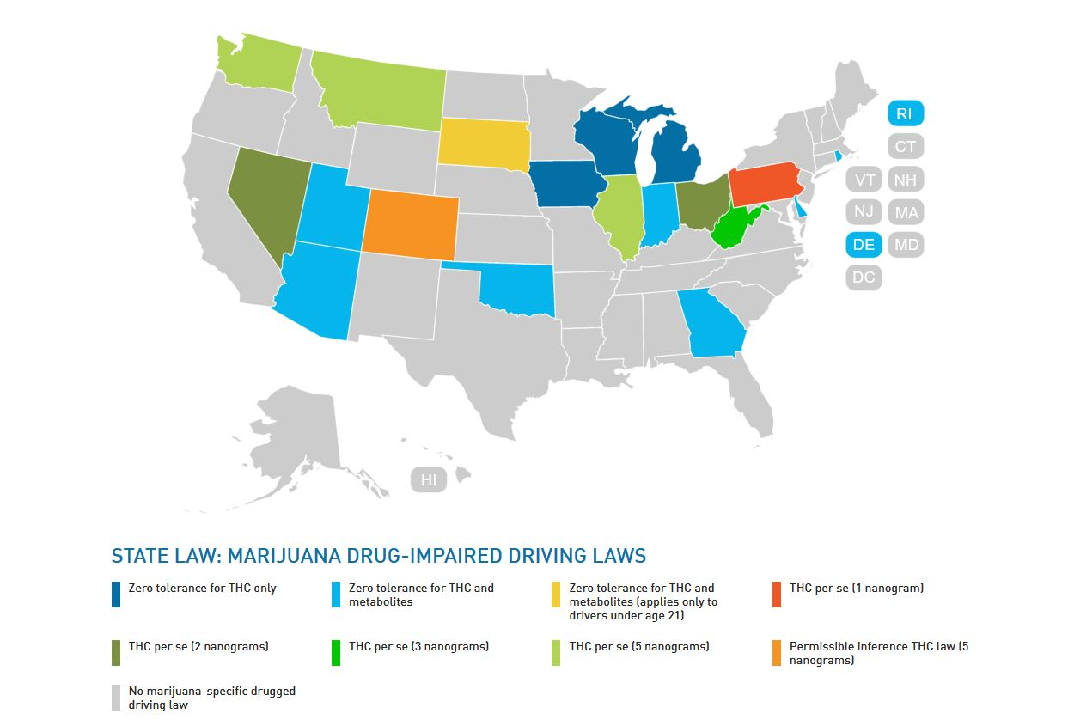

Slide 5
Relationship to traffic safety
In 2016 a report by the AAA Foundation for Traffic Safety found that fatal crashes of drivers who recently used marijuana doubled after the State of Washington legalized it.
An online survey in April by the department found that 69 percent of pot users said they had driven under the influence of marijuana at least once in the past year and 27 percent said they drove high almost daily.
Many recreational users said they didn’t think it affected their ability to drive safely.

Slide 6
What is a dre
A drug recognition expert or drug recognition evaluator (DRE) is a police officer trained to recognize impairment in drivers under the influence of drugs other than, or in addition to, alcohol.
Program initiated in 1970s by LAPD
Got the attention of the National Highway Traffic Safety Administration (NHTSA) in the 1980s
Pilot programs and studies conducted by NHTSA in the 1980s

Slide 7
ALCOHOL DWI VS DRUG DWI
ALCOHOL
DRUG
.08 PER-SE ‘STANDARD’
INDICATORS OF IMPAIRMENT
ODOR
SLURRED SPEECH
BLOODSHOT/WATERY EYES
NO STANDARD OF ‘PER SE’
NO RESEARCH
MULTIPLE INDICATORS OF IMPAIRMENT

Slide 8
IACP/NHTSA
6 Countries
Every State
NM since early 90’s
72
10 Instructors

Slide 9
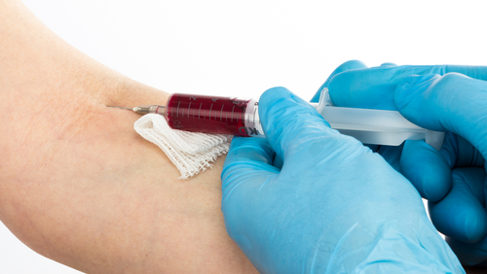
birchfield
What does it mean?
No blood without consent/warrant
How do we show impairment with no blood?
How about with blood?

Slide 10

What is the dre doing??
DRE documents the evaluation on standardized report form
DRE documents their opinion
Possibilities include:
Medical rule out
Not impaired
Alcohol only

Slide 11
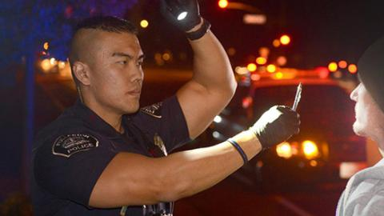
What is the dre doing??
Not impaired
(6.82% since January 2017)
Alcohol only
(1.14% since January 2017)
One drug category
Poly drug
Medical Condition
(2.27 % since January 2017)

Slide 12
What a dre eval can do
Probable cause to request chemical test
BIRCHFIELD!!
Rule out medical if possible-liability
Refusal (blood)
Unable to obtain blood-veins or no blood tech

Slide 13
What a dre eval can do
Drugs in blood not indicative of impairment
Cost of blood test to agency
Labs follow DRE lead on what to look for
Unable to obtain blood-veins or no blood tech

Slide 14
WHATS THE POINT?
Impaired driving cases are already very subjective in nature
Opinion
Drug impaired driving cases much more so
Cant rely on blood
The DRE is trained to look for the IMPAIRMENT
Not always impairment
Beyond a reasonable doubt
Accountability

Slide 15
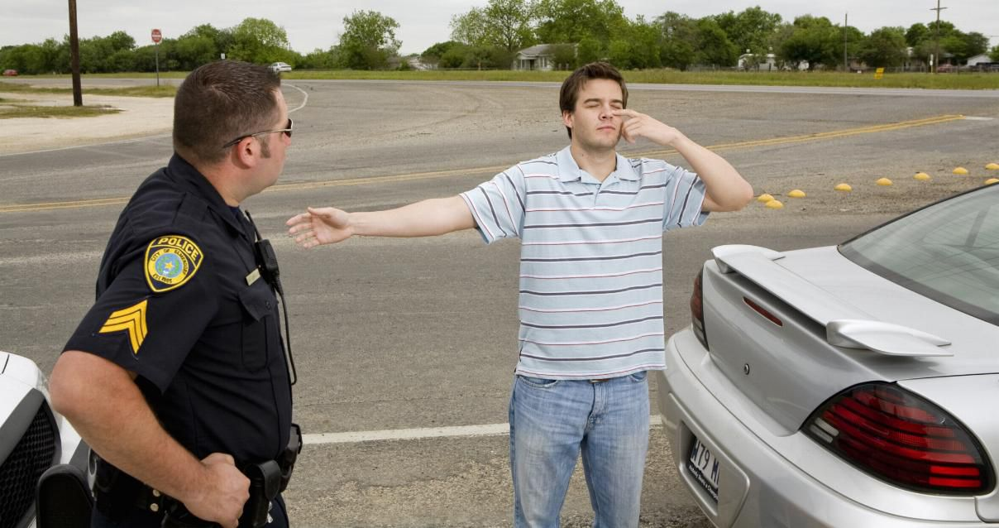
Training available
One DRE School/Certification per year
Three phase process- IACP Standards
Grant funded
18 ARIDEs around the State annually
Two day course
Grant funded

Slide 16

www.nmdre.org

Slide 17

Thank you for your time

